Slide 1


Navigate your way through the Spring Ecosystem
Mike.Genovese@daugherty.com

Slide 2


Historically Speaking
Collection of packages and modules to address J2EE complexities
J2EE
Spring
Simplify
Decouple
Tight integration
EJBs
DI / IoC
POJOs
Transaction Management
AOP
…
Spring MVC

Slide 3

Overview
Spring
Notes:
Problem framing and name

Slide 4
Overview
Spring
DI, MVC, Transaction Management
Notes:
Problem framing and name

Slide 5
Overview
Spring Framework
Notes:
Problem framing and name

Slide 6
Overview
Spring Framework
Spring IO
Notes:
Problem framing and name

Slide 7
Overview
Spring Framework
Spring IO
Spring IO Platform
Notes:
Problem framing and name

Slide 8
Overview
Spring Framework
Spring IO
Spring IO Platform
Spring Boot
Notes:
Problem framing and name

Slide 9
Overview
Spring Framework
Spring IO
Spring IO Platform
Spring Boot
Spring Core
Notes:
Problem framing and name

Slide 10
Overview
Spring Projects
Notes:
Problem framing and name

Slide 11
Overview
Spring Security
Notes:
Problem framing and name

Slide 12
Overview
Spring Security
Spring Data
Notes:
Problem framing and name

Slide 13
Overview
Spring Security
Spring Data
Spring Cloud
Notes:
Problem framing and name

Slide 14
Overview
Spring Security
Spring Data
Spring Cloud
Spring Batch
Notes:
Problem framing and name

Slide 15
Overview
Spring Security
Spring Data
Spring Cloud
Spring Batch
Spring XD
Notes:
Problem framing and name

Slide 16
Overview
Spring… whatever
Notes:
Problem framing and name

Slide 17
Overview
Spring-data
Spring-framework
Spring-flo
Spring-integration-aws
Spring-roo
Spring-integration
Spring-amqp
Spring-data-solr
Spring-boot
Spring-data-neo4j
Spring-statemachine
Spring-data-redis
Spring-data-gemfire
Spring-kafka
Spring-security-oath
Spring-security-saml-dsl
Spring-hateoas
Spring-xd
Spring-restdocs
Spring-ldap
Spring-data-couchbase
Spring-reactive
Spring-data-elasticsearch
Spring-integration-kafka
Spring-data-cassandra
Spring-data-commons
Spring-integration-java-dsl
Spring-cloud
Spring-social
Spring-guice
Spring-data-aerospike
Spring-android
Spring-xd-ambary
Spring-integration-dsl-groovy
Spring-social-linkedin
Spring-data-jdbc-ext
Spring-mobile
Spring-xd-ec2
Spring-scala
Spring-integration-dsl-scala
Spring-bus
Spring-integration-flow
Spring-flex
Spring-test-mvc
Spring-data-grid
Spring-ws
Spring-data-cassandra
Spring-data-commons
Spring-integration-java-dsl
Spring-data-jpa
…
And many, many more
Spring
Spring-session
Spring-batch
Spring-hadoop
Spring-data-mongodb
Spring-shell
Spring-tuple
Spring-loaded
Spring-social-github
Spring-security-kerberose
Spring-security-saml
Spring-data-rest
Spring-social-facebook
Spring-social-twitter
Spring-webflow
Notes:
Same original screen of problem statement, but now cleanly organized

Slide 18


















Spring.io – main Spring Projects
Spring IO Platform
Spring Boot
Spring Framework
Spring Cloud
Spring Data
Spring Integration
Spring Batch
Spring Security
Spring HATEOS
Spring Social
Spring AMQP
Spring Mobile
Spring Web Flow
Spring Web Services
Spring LDAP
Spring Session
Spring XD
… and more
https://spring.io/projects - omitted Spring Shell, Spring for Android, Spring Cloud Data Flow, and Community Projects

Slide 19
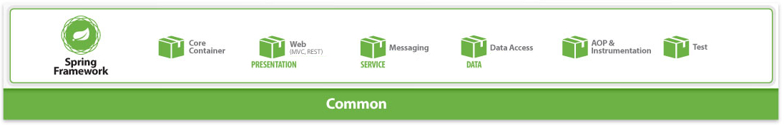
Organizing
Foundational
Cross-tier
Core Capabilities

Slide 20
Organizing
spring-aop
spring-aspects
spring-beans
spring-context
spring-context-support
spring-core
spring-expression
spring-instrument
spring-instrument-tomcat
spring-web
spring-webmvc
spring-webmvc-portlet
spring-websocket
…
…
Spring Framework Modules
http://docs.spring.io/spring/docs/4.3.0.RC1/spring-framework-reference/htmlsingle/

Slide 21

Organizing
spring-aop
spring-aspects
spring-beans
spring-context
spring-context-support
spring-core
spring-expression
spring-instrument
spring-instrument-tomcat
spring-web
spring-webmvc
spring-webmvc-portlet
spring-websocket
…
…
Core Container
Web (Presentation)
http://docs.spring.io/spring/docs/4.3.0.RC1/spring-framework-reference/htmlsingle/

Slide 22
Organizing
spring-aop
spring-aspects
spring-beans
spring-context
spring-context-support
spring-core
spring-expression
spring-instrument
spring-instrument-tomcat
spring-web
spring-webmvc
spring-webmvc-portlet
spring-websocket
…
…
Core Container
Web (Presentation)
http://docs.spring.io/spring/docs/4.3.0.RC1/spring-framework-reference/htmlsingle/

Slide 23
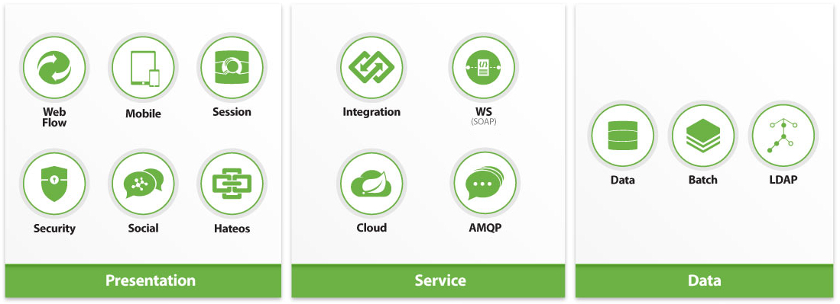
Organizing
Capabilities by Tier

Slide 24
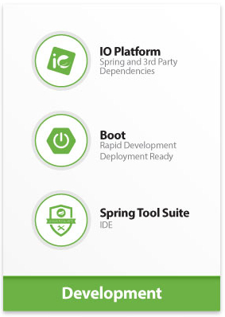

Organizing
Development Improvements
Big Data Streaming

Slide 25
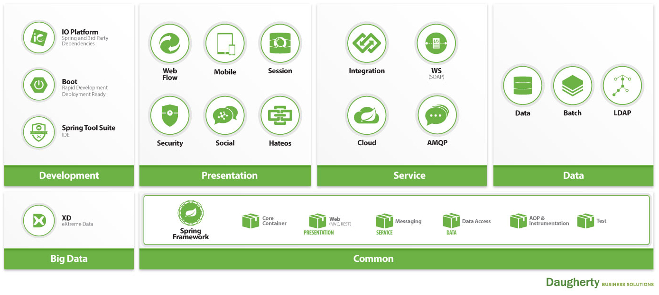
Spring Ecosystem

Slide 26
Spring Ecosystem
So What?

Slide 27
Spring Ecosystem

Slide 28

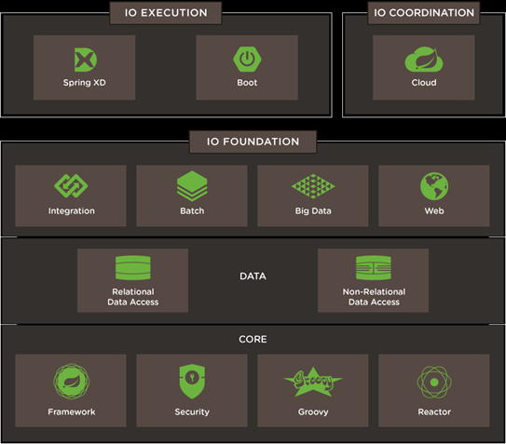
Spring IO Platform
Dependency Management Solution
Certified deliverable of libraries with locked down, compatible versions
Logical Construct
IO Execution
IO Coordination
IO Foundation
Spring and 3rd Party Libraries
https://spring.io/platform

Slide 29
Spring IO Platform
Dependency Management Solution
Certified deliverable of libraries with locked down, compatible versions
“Spring IO”
https://spring.io/platform

Slide 30
Spring IO Platform
Set the Spring IO Platform for dependency management
<dependencyManagement>
<dependencies>
<dependency>
<groupId>io.spring.platform</groupId>
<artifactId>platform-bom</artifactId>
<version>2.0.4.RELEASE</version>
...
Let Spring IO Platform manage dependency versions
<dependency>
<groupId>org.springframework</groupId>
<artifactId>spring-core</artifactId>
</dependency>
<dependency>
<groupId>org.springframework</groupId>
<artifactId>spring-core</artifactId>
<version>4.2.6.RELEASE</version>
</dependency>
VS

Slide 31

Spring Boot
Much more than… bootstrapping
Rapid Development
Deployment Ready
Application Management and Monitoring

Slide 32
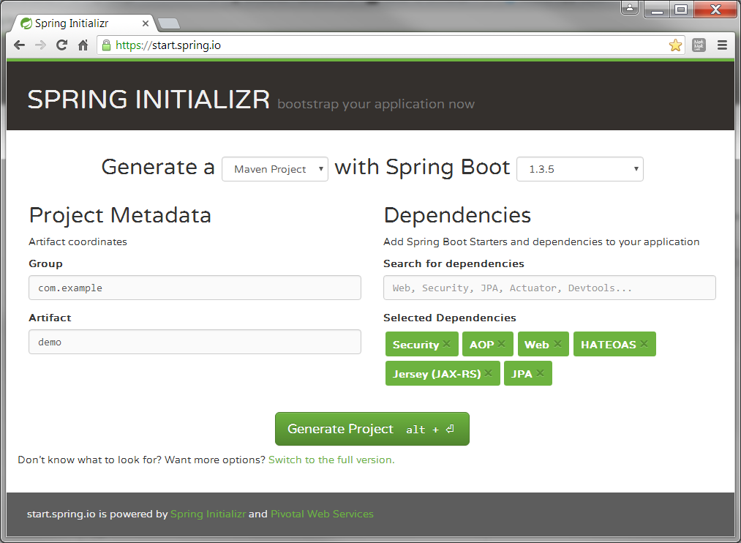
Spring Boot
Rapid Development
Starters
Auto Configure
@RestController
@EnableAutoConfiguration
public class CustomerController {
@RequestMapping("/findCustomers")
public List<Customer> findCustomers() {
…
return Customers;
}
…

Slide 33

Spring Boot
Deployment Ready
Server
Application
Application
Server
@SpringBootApplication
public class App {
public static void main( String[] args ) {
SpringApplication.run(App.class, args);
}
}
$ java -jar myproject.jar

Slide 34
Spring Boot
Application Management and Monitoring
Spring Boot Actuator
- endpoints to monitor and interact with your application
Beans – list of all Spring beans in your application
Configprops – list of all @ConfigurationProperties
Dump – performs a thread dump
Health – application health information
Info – arbitrary application information
Metrics – metrics information (eg. memory uptime, threads)
Mappings – list of all @RequestMapping paths
Shutdown – gracefully shutdown application
etc.

Slide 35

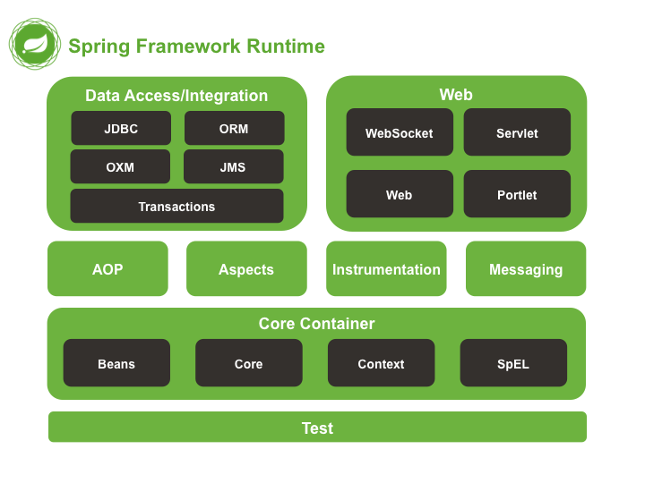
Spring Framework
Modules
spring-aop
spring-aspects
spring-beans
spring-context
spring-context-support
spring-core
spring-expression
spring-instrument
spring-instrument-tomcat
spring-jdbs
spring-jms
spring-messaging
spring-orm
spring-oxm
spring-test
spring-tx
spring-web
spring-webmvc
spring-webmvc-portlet
spring-websocket
http://docs.spring.io/spring/docs/4.3.0.RC1/spring-framework-reference/htmlsingle/

Slide 36
Spring Framework
Feature Rich
DI, AOP, MVC, REST, Messaging, Web Sockets, Test, Transactions, etc.
Foundational
Leveraged for extended capabilities and features
http://docs.spring.io/spring/docs/4.3.0.RC1/spring-framework-reference/htmlsingle/

Slide 37

How do these projects “fit”?

Slide 38
Spring Ecosystem

Slide 39
Spring Ecosystem

Slide 40

Spring Cloud
Common Patterns
Distributed/versioned configuration
Service registration and discovery
Routing
Service-to-service calls
Load balancing
Circuit Breakers
Global locks
Leadership election and cluster state
Distributed messaging
Microservices
http://projects.spring.io/spring-cloud/

Slide 41

Spring Cloud
Sub Projects
Spring Cloud Config
Spring Cloud Bus
Spring Cloud Cluster
Spring Cloud Security
Spring Cloud Sleuth
Spring Cloud Data Flow
Spring Cloud Stream
Spring Cloud Stream Modules
Spring Cloud Task
Spring Cloud Connectors
Spring Cloud Starters
Spring Cloud CLI
Spring Cloud Consul
Spring Cloud for Cloud Foundry
Spring Cloud for Amazon Web Services
Spring Cloud Netflix
Spring Cloud Zookeeper
http://projects.spring.io/spring-cloud/

Slide 42

Spring Cloud
Spring Cloud Netflix… not just for streaming video
Integrate cloud capabilities from Netflix’s
Open Source Software Center
Including
Service Discovery (Eureka)
Circuit Breaker (Hystrix)
Intelligent Routing (Zuul)
Client Side Load Balancing (Ribbon)
http://projects.spring.io/spring-cloud/

Slide 43

Spring XD - eXtreme Data
Big Data Streaming
Ingestion
Orchestration
Extraction
Analytics

Slide 44
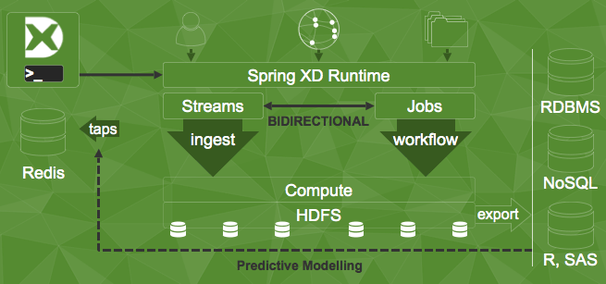
Spring XD - eXtreme Data
Distributed Runtime
http://projects.spring.io/spring-xd/

Slide 45
Spring XD - eXtreme Data
Built on
Spring Framework
Spring Integration
Spring Data
- Spring for Apache Hadoop
Spring Batch
Spring Boot

Slide 46

Evolution / Change

Slide 47

Evolution / Change
Spring XD
Spring Cloud Data Flow
Announcement
Building upon Spring Boot and Spring Cloud capabilities, Spring XD is actively being redesigned as Spring Cloud Data Flow - a cloud native programming and operating model for composable message-driven microservices.
- http://projects.spring.io/spring-xd/

Slide 48

Recap
Find your way in the Spring Ecosystem
Know the capabilities
Use what you need
Expect change

Slide 49
Spring Ecosystem

Slide 50
Overview
Spring
Development
Presentation
Service
Data
IO Platform
Web Flow
Mobile
Cloud
Batch
Boot
Session
Social
WS
Data
STS
Security
Hateos
Integration
LDAP
AMQP
Big Data
Common
XD
Core Container
AOP & Instrumentation
Spring Framework
Web
Messaging
Data Access
Test
Notes:
Same original screen of problem statement, but now cleanly organized

Slide 51
Overview
Spring
?s
Notes:
Same original screen of problem statement, but now cleanly organized

Slide 52
Overview
Spring
Spring IO
Spring IO Platform
Spring.io - website
What does IO stand for?
Notes:
Same original screen of problem statement, but now cleanly organized

